Slide 1
Begin your notes by writing down the following… you have 2 minutes!
Title: Australia’s Economy
Learning Intention: Understand the concepts of Economics and the parts of the Australian Economy
Success Criteria: Can list x3 imports and exports of Australia. Can name the 5 key participants in the Australian Economy.
2:00
1:59
1:58
1:57
1:56
1:55
1:54
1:53
1:52
1:51
1:50
1:49
1:48
1:47
1:46
1:45
1:44
1:43
1:42
1:41
1:40
1:39
1:38
1:37
1:36
1:35
1:34
1:33
1:32
1:31
1:30
1:29
1:28
1:27
1:26
1:25
1:24
1:23
1:22
1:21
1:20
1:19
1:18
1:17
1:16
1:15
1:14
1:13
1:12
1:11
1:10
1:09
1:08
1:07
1:06
1:05
1:04
1:03
1:02
1:01
1:00
0:59
0:58
0:57
0:56
0:55
0:54
0:53
0:52
0:51
0:50
0:49
0:48
0:47
0:46
0:45
0:44
0:43
0:42
0:41
0:40
0:39
0:38
0:37
0:36
0:35
0:34
0:33
0:32
0:31
0:30
0:29
0:28
0:27
0:26
0:25
0:24
0:23
0:22
0:21
0:20
0:19
0:18
0:17
0:16
0:15
0:14
0:13
0:12
0:11
0:10
0:09
0:08
0:07
0:06
0:05
0:04
0:03
0:02
0:01
End

Slide 2
Australia & the
Global Economy
Find page 39 in HASS 9 Textbook
30
29
28
27
26
25
24
23
22
21
20
19
18
17
16
15
14
13
12
11
10
9
8
7
6
5
4
3
2
1
End

Slide 3
$330,313,000,000
Whoa! That’s a big number!

Slide 4
$330,313,000,000
The total value of exports to Australia in 2016

Slide 5
$342,416,000,000
The total value of imports to Australia in 2016.
That’s an even bigger number!

Slide 6
So what does Australia Export and Import?

Slide 7
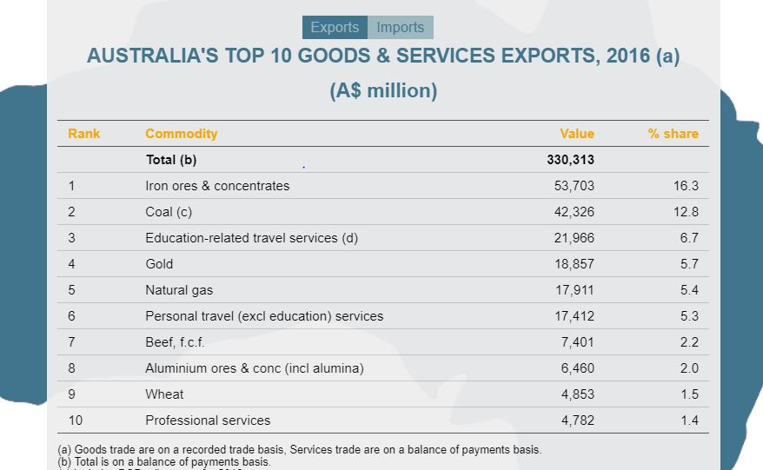

Slide 8
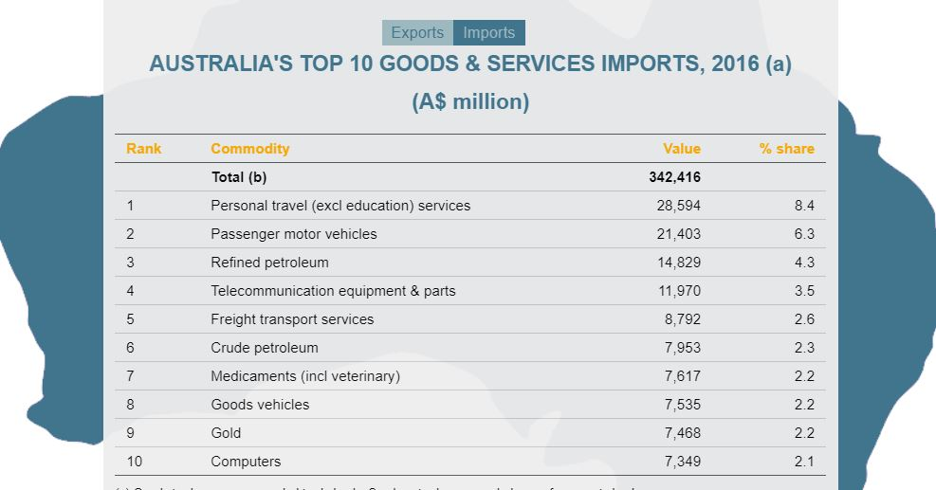

Slide 9

Did you know…
Australia Exports camels to Saudi Arabia?

Slide 10
Exports Imports
Gold
Natural Gas
Wheat
Coal
Education related travel services
Beef
Iron ores & concentrates
Passenger motor vehicles
Tourism
Computers
Telecommunication equipment & parts
Medicaments
Refined Petroleum
Freight transport services

